Slide 1
HW11
Connect Four Due: December 21th 23:59:59
AI Due: December 28th 23:59:59
Delay is NOT allowed.
(GAME) Filename: HW#_StuID.zip
Ex) HW11_Q12345678.zip
(AI) UPLOAD your header only

Slide 2
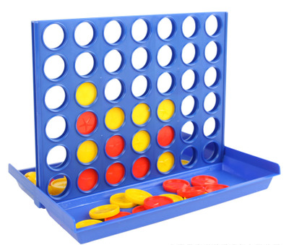

Rules
6 rows, 7columns
Two players
21 red discs and 21 yellow discs
Every round, players drop one of their discs into an unfilled column
The player who achieves “four in a row” first is the winner
If the game board fills before player achieve four in a row, the game is a draw

Slide 3
Connect four game:
Write a program letting 2 users play Connect Four
Use only basic rules
Update and show the game board after each move
When the game ends, determine and show which player is the winner or the game is a draw
Include a “README.txt” to instruct how to play your game

Slide 4
AI:
Write an AI to compete with your classmates
Time for decision in each step is limit to 1 second
Upload one header file only → Stu_ID.h

Slide 5
You can get three files
Source.cpp : Don’t change any code in this file
E12345678.h : Change the file name and function name to your Stu_ID → Upload this file only
Poor_AI.h : Write a simple AI for testing
Change E12345678.h to Stu_ID.h after completing AI or you have to change file name and function name in source code.

Slide 6
Source.cpp
Call two AIs to compete for 100 times
Players drop the first disc by turns
The AI which wins more times is the winner
The round ends by some cases
Someone wins when connecting four
The board is full (Draw Game)
Someone does illegal move (The other player wins)

Slide 7
Source.cpp
vector < vector<char> >board
Use 6x7 vector to store the state of board
0 1 2 3 4 5 6
0
1
2
3
4
5
 |  | X | O
 |  | O | X
 | X | O | O | X

Slide 8
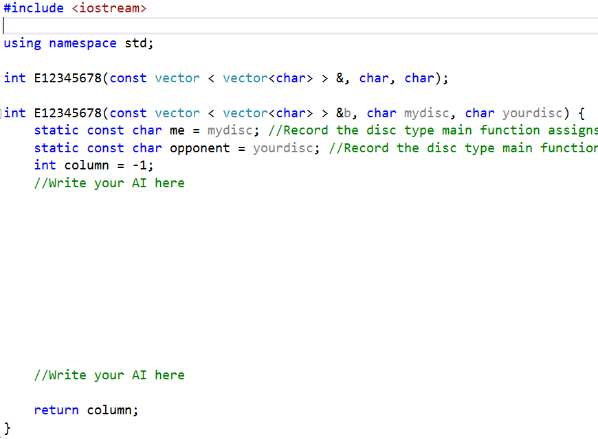
Change file name and
function name to your Stu_ID before uploading
E12345678.h
Given: board, disc (O or X)
Return: updated board

Slide 9
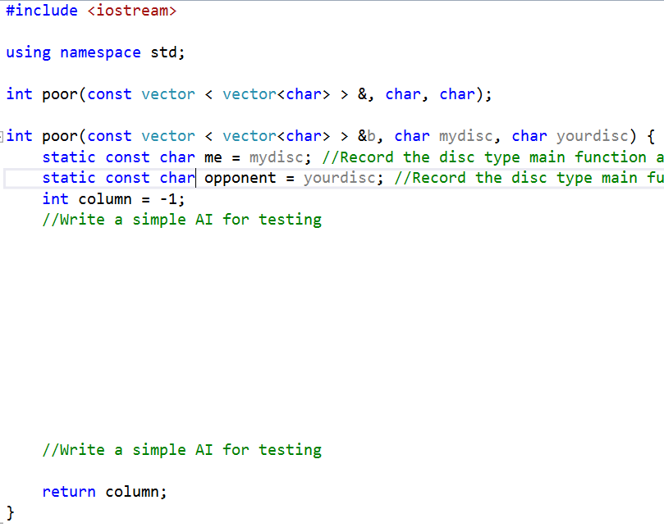
Poor_AI.h

Slide 10
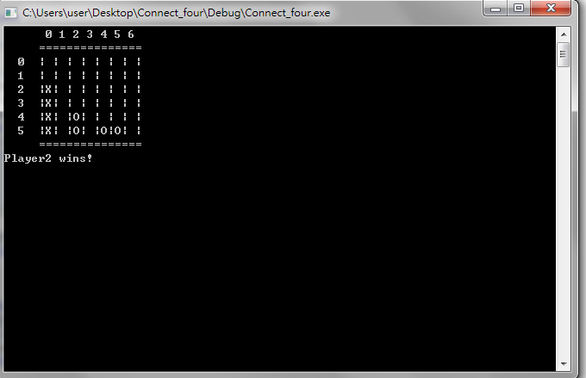
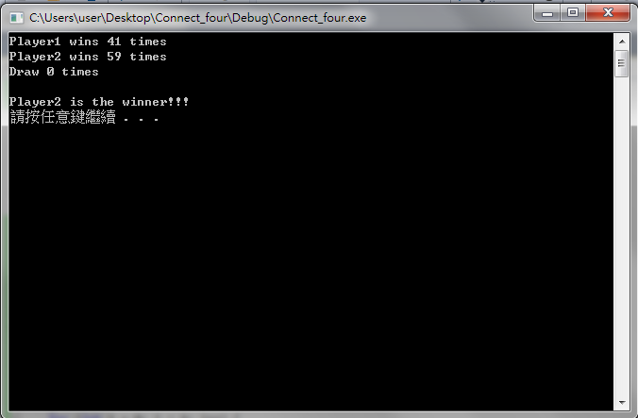
DEMO

